Slide 1
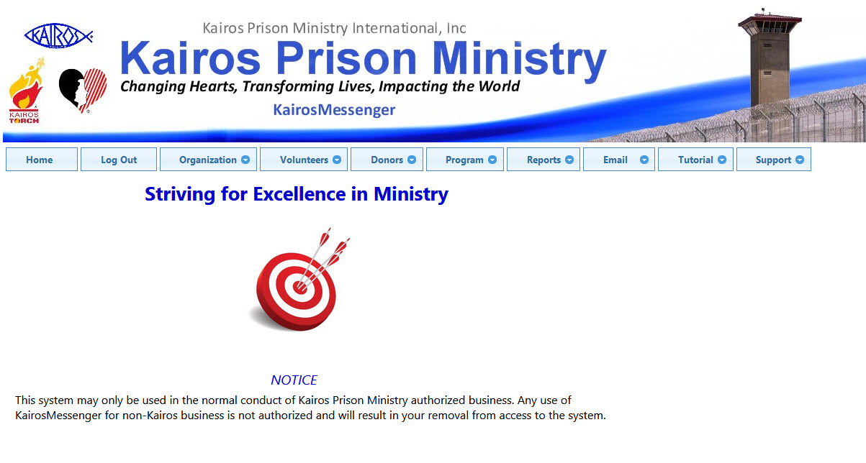
KairosMessenger

Slide 2
Purpose of KairosMessenger
A ministry-wide system that integrates standard tools and processes to improve communications, reporting, and analysis throughout the ministry in order to help improve our striving for excellence.

Slide 3



KairosMessenger “Family”
KairosMessenger
KairosEzra.com
KairosDonorSupport.com

Slide 4
KairosMessenger Overview
Organization
Dashboard
Member List
Elections
Prison/Admin
Facilities/Hotels
Volunteers
Dashboard
Volunteer List
Volunteer Dir
Program
Dashboard
Weekend
- History
- Participant
- EI Reports
- Continuing Min
Reports
Dashboards
Reporting
- State Status
Email
Email List
Create/Send
Email Log

Slide 5
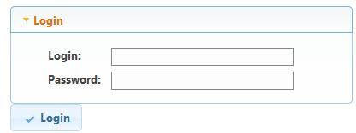
Login/Authorization
Authorization Required
Based on ACOP/SCCOP Election
Identifies Geographic Scope
(ie Advisory Council or State Wide)
Identifies Elected Role Responsibilities
(in accordance wit ACOP/SCCOP)

Slide 6

Ministry “Pillars”

Slide 7
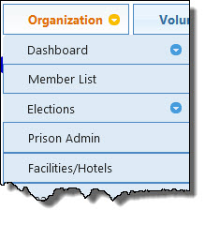
Organization
Identifying elected persons for Advisory Council and State Chapter Committee
Once place to access and update elections
Prison & Facility contacts for Advisory Council or State Chapter

Slide 8
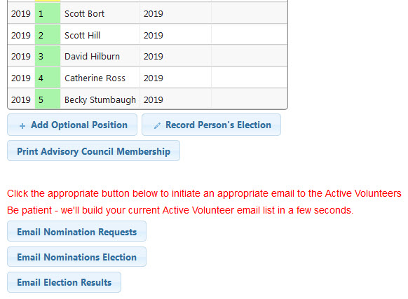
Elections
In accordance with ACOP/SCCOP procedures
Secretary emails to “Active” Volunteers
Nomination Request
Election Request
Election Results
Elected Persons’ Job Description and Password

Slide 9
Election Issues
Only record “remove year” if person resigns during term
Record elections annually (one year terms)
Authorization expires Jan 31 of following year
Electable persons must be in Volunteer database

Slide 10
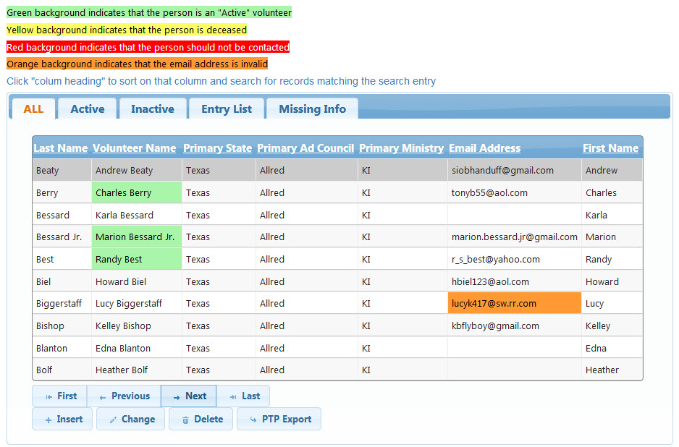
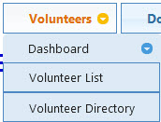
Volunteers

Slide 11
Volunteers
Ezra is the source of data
Uploaded when “Copy Files for Next Leader” done
Duplicate Entries (and how to avoid them)
Must be “primarily associated” with one ministry
Can serve on Weekends at multiple Advisory Councils
Bad contact data in Ezra results in bad data in KairosMessenger

Slide 12
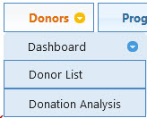
Donors
Future Addition
Data Source from KairosDonor

Slide 13
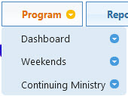
Program
Excellence Initiative History/Print
Leader Report History/Print
Participant Inquiry (Future)
Continuing Ministry (Future)

Slide 14

Reports
State Status Report
# Volunteers
- Active
- Total
# Elected Positions
Chair/Secretary contact information

Slide 15
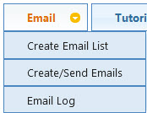
Email (KairosMail)
Automatically creates dynamic email list
Related to elected role of sending person
Auto creates email text
Related to elected role of sending person
Customizable
Bulk Email

Slide 16
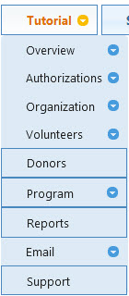
Tutorials
Video and PDF Tutorials
Login not required

Slide 17
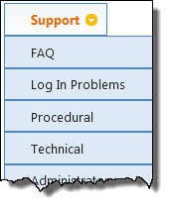
Support
Frequently Asked Questions
Support Contacts
Login Questions
Procedural Questions
Tech Support Questions

Slide 18
Things We’ve Learned
Lacking knowledge of Advisory Council Operating Procedures
Inconsistent passing of Ezra data from leader to leader
Incomplete Contact information in Ezra
Inactive volunteers not being contacted

Slide 19
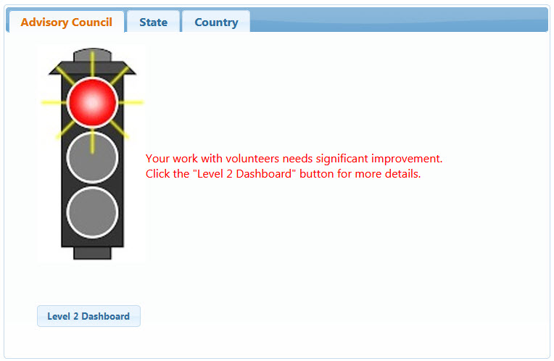
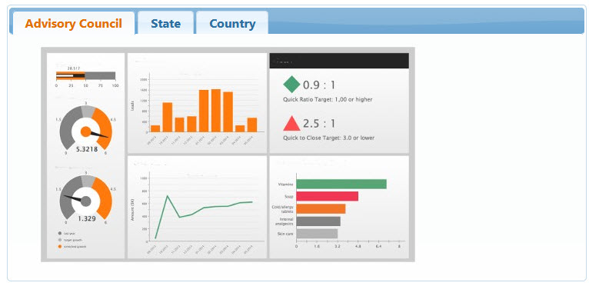
Future Attractions
Level 1
Data De-Dup
Based on what we’ve learned
Continuing Ministry
Attendance based (team & participants)
Dashboard Reporting
Set for Organization, Volunteers, Donors, Program
Participant Inquiry
Statewide searches on DOC number
Level 2

Slide 20
Questions

